Slide 1
Welcome
MyGame is called:
Player:Chicken:One
© 2024 OTH Amberg-Weiden

Slide 2
Agenda
01
Basic Ideas & Insights
04
Objects and Creatures
02
Dynamic Map-Generation
05
Stats and Interactions
03
Scene Setup & Move to 3D
06
Notes and Tech-Details

Slide 3
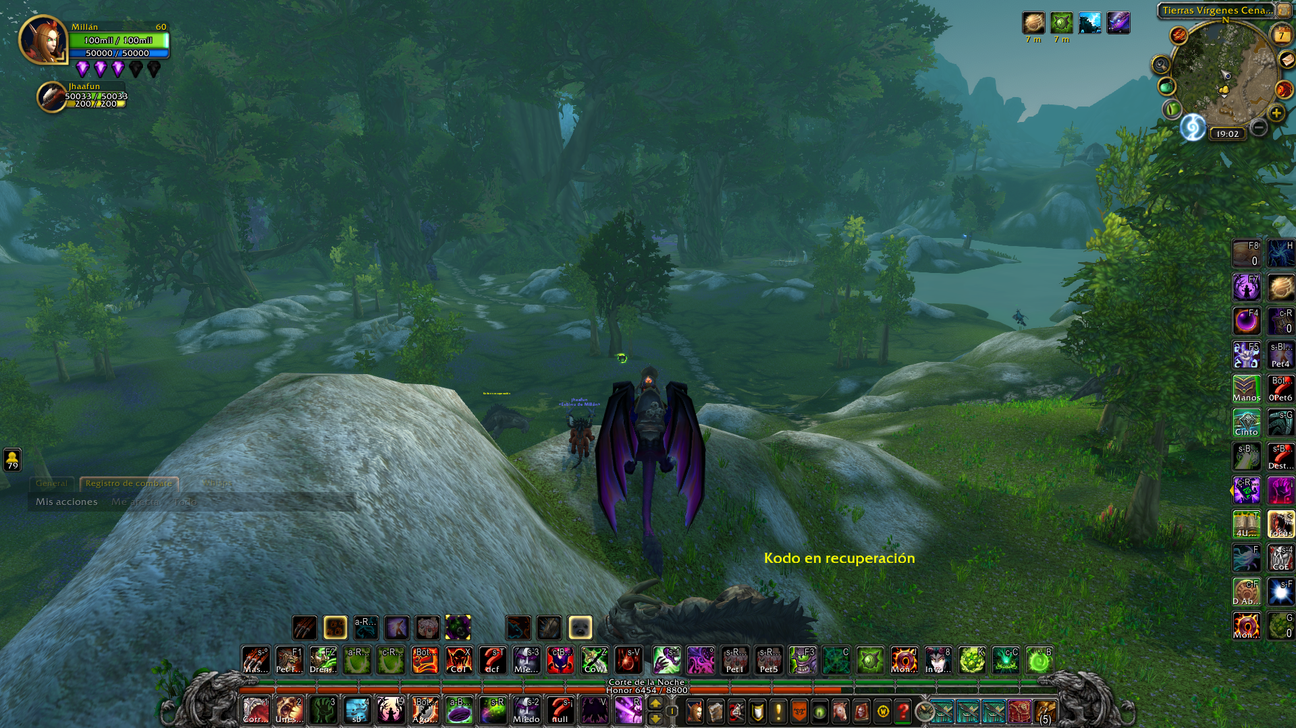
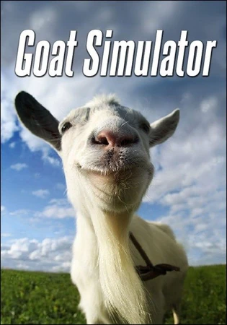
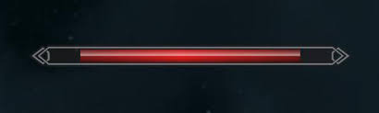
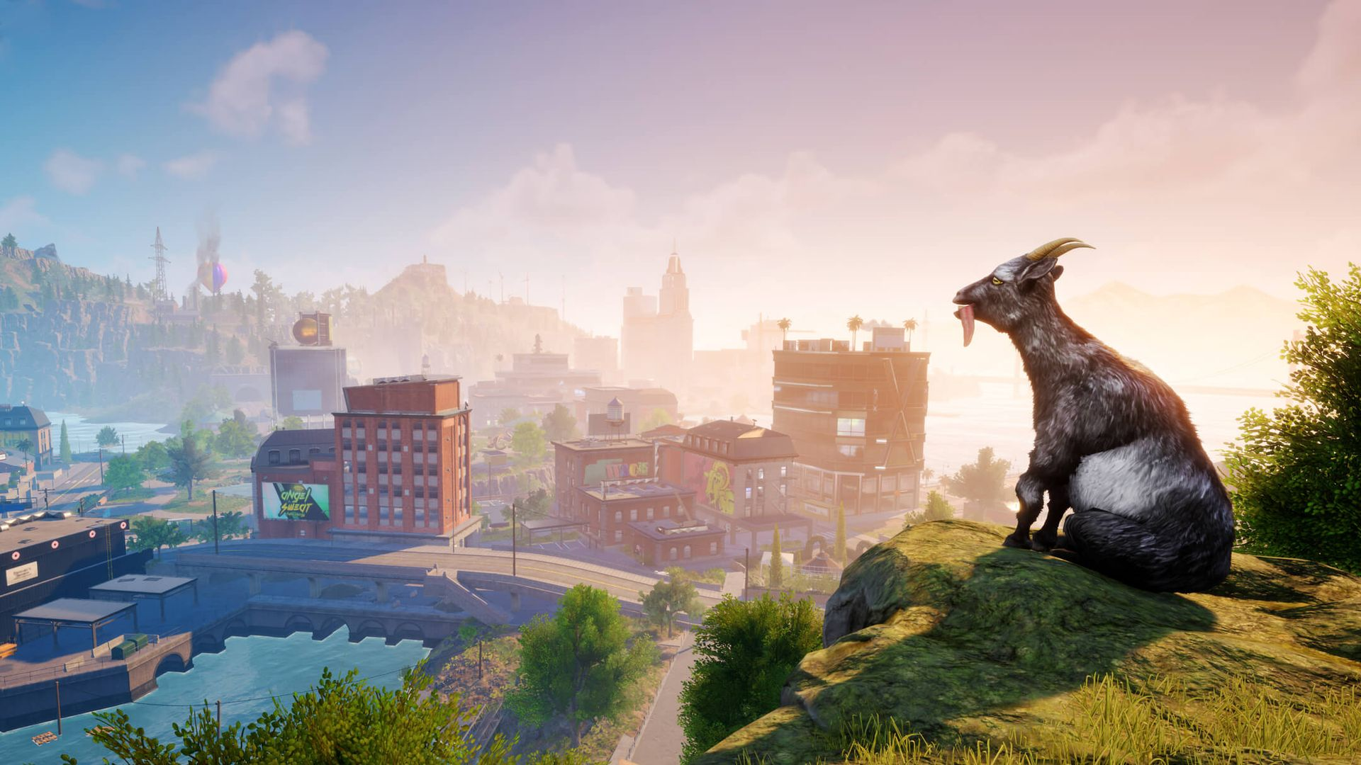
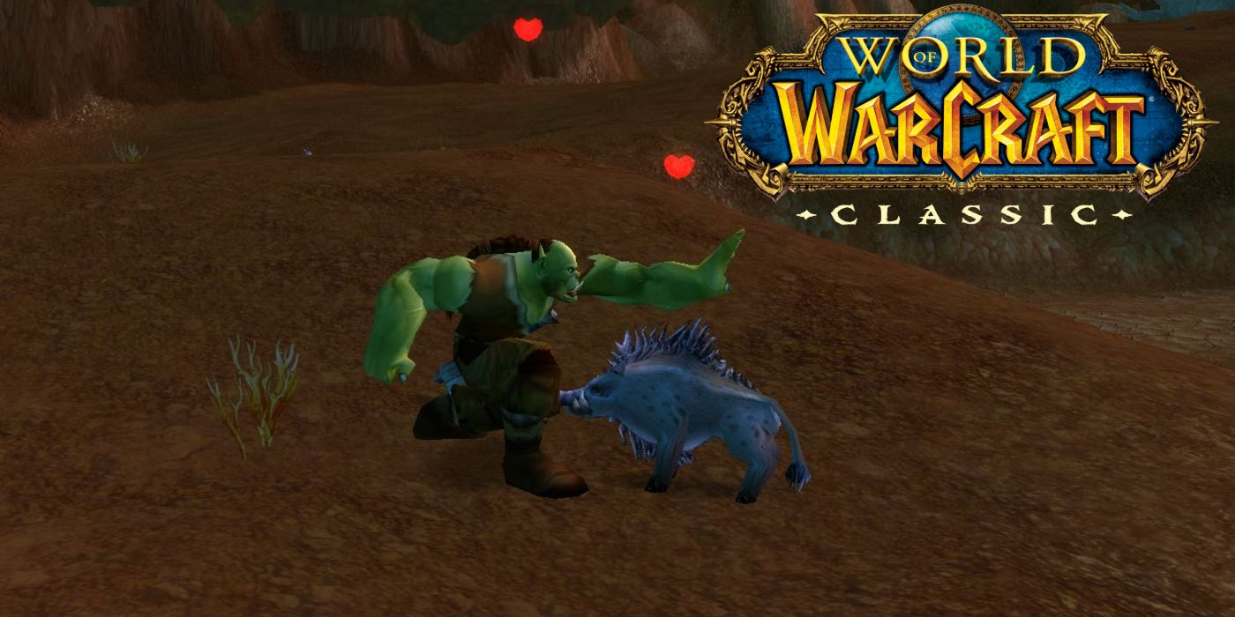
Ideas & Insights| PlayerChicken1
The final idea only became lucid during the development process…
My Vision (not representing current state):
&
Quellen: https://www.maniac.de/wp-content/uploads/2022/07/goat-simulator-3-BIG.jpg. |. https://static.wikia.nocookie.net/game-pedia/images/0/06/GoatSimulator_Frontcover.jpg/revision/latest/thumbnail/width/360/height/450?cb=20231118082603&path-prefix=de

Slide 4
Ideas & Insights
You spawn with a chicken creature in the first biome
There are 3 biomes
You can Move with WASD
You can run with shift + WASD
You can attack with ‘J’ (this is currently the only attack)
There are peaceful and non peaceful NPC-creatures on the map
Kill 3 creatures in each Biome to move forward and lift the fog of war
You can only proceed after killing 3 npc-creatures
There are 3 types of interactables in each biome
There are 3 different types of npc-creatures
Be aware of the Tiger

Slide 5
Dynamic Map-Generation

Slide 6
Dynamic Map-Generation
I started out with the dynamic construction of a map
Learned the fundamentals of Unity (TileMaps, …)
Lesson: anything that isn’t static is dynamic
→ Devise your own logical sequence of steps to reach the goal of a procedurally generated map
Quellen:

Slide 7
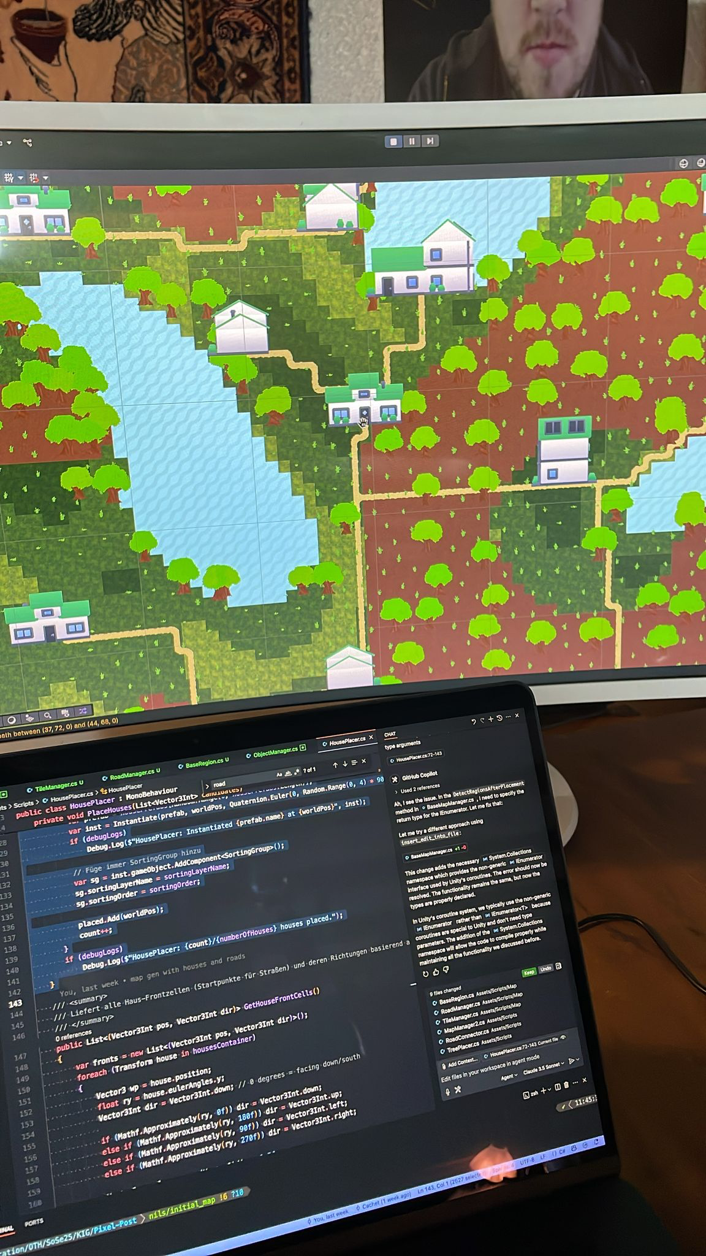
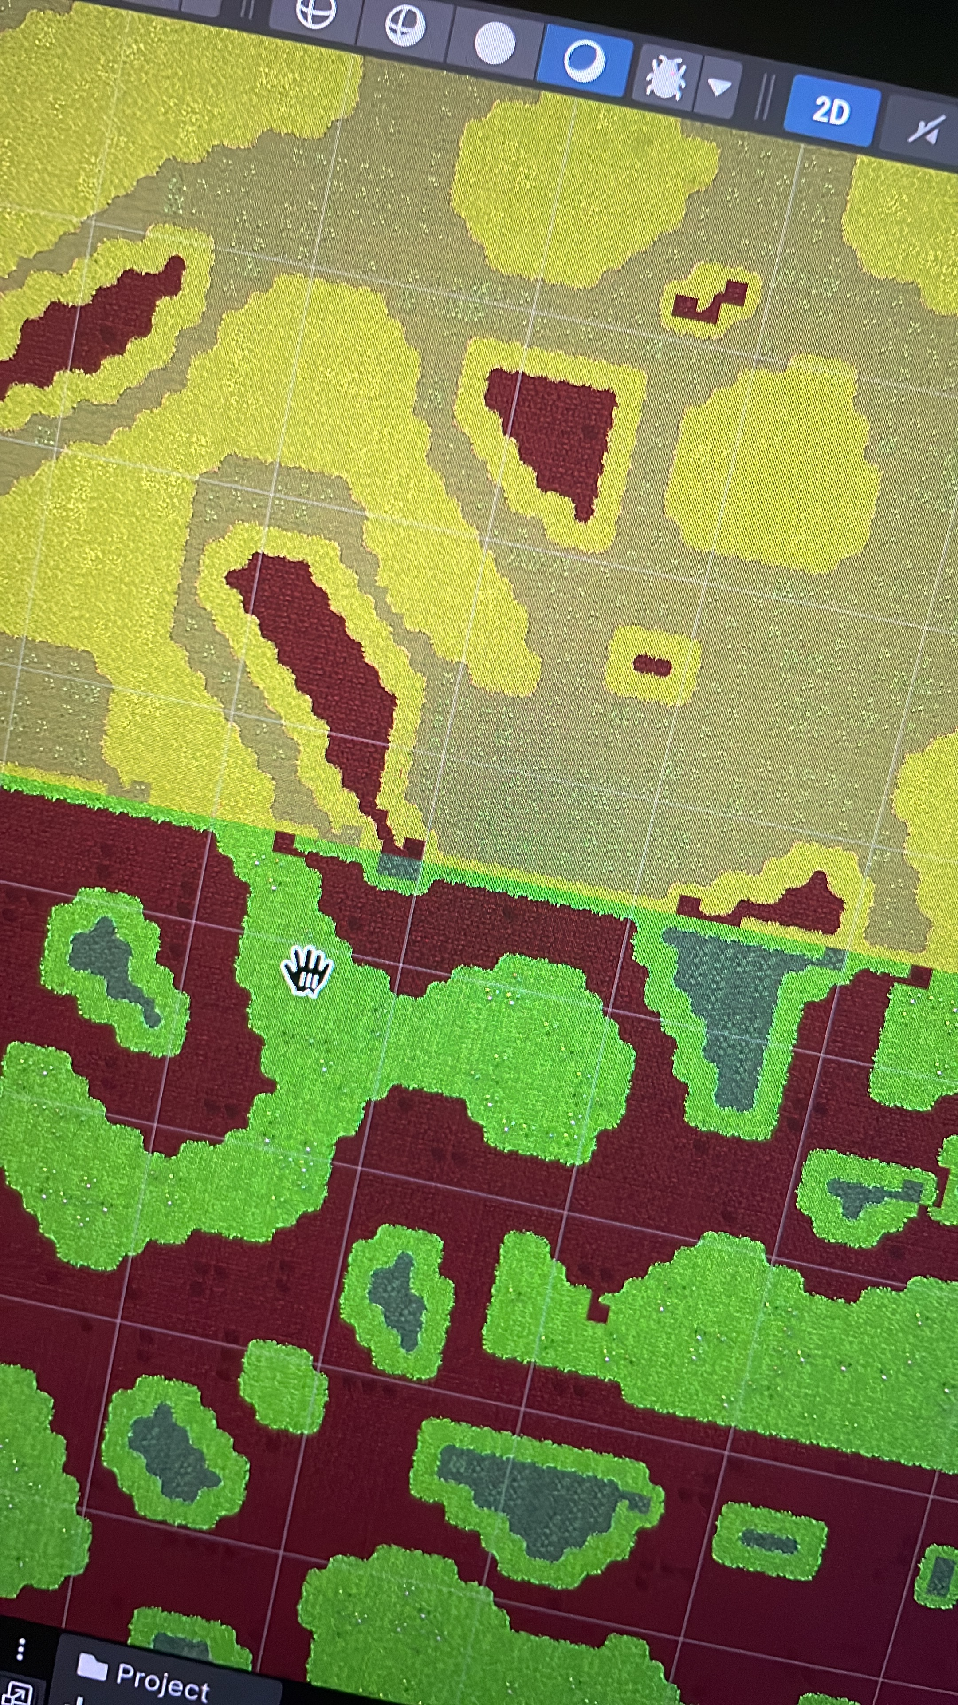
Dynamic Map-Generation
First Steps
Started spawning Objects
Simple N x N sized squares, filled with simple Tiles
Using noise functions
Simple N x N sized squares, filled with simple Tiles
Went from one color tiles to multi color tiles (to replace time intensive rules)
Differentiate between layers
BaseLayer
EarthLayer
WaterLayer
RoadLayer
PropsLayer
Bottom-up principle (first lay out the baseLayer)

Slide 8
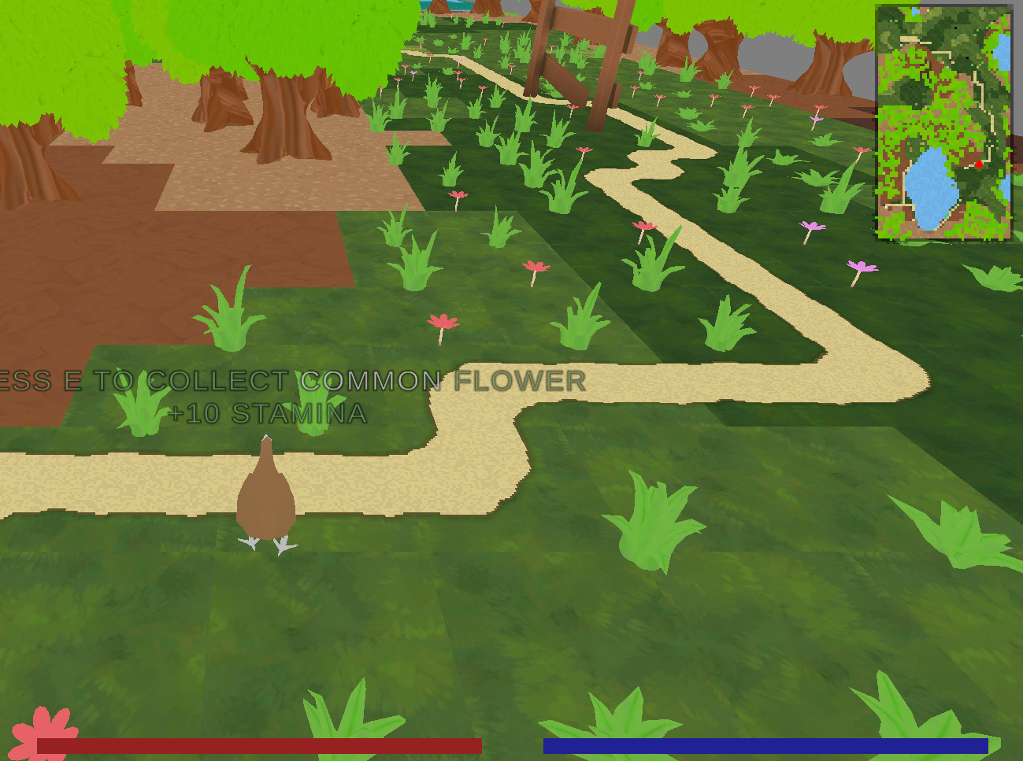
Dynamic Map-Generation
Result with MiniMap and UI-Overlays
Crucial was the way the Grid is layed out in 3D space
Important to correctly configure:
ObjectRotations
Gravity aspects
Movement of PlayerCreature

Slide 9
Dynamic Map-Generation
GameObjects & Components
BaseMapManager_1
MapGenerationManager
BaseMapManager_2
.
.
.
LevelManager
BaseMapManager_n
// Input:
A Set of BiomeConfigs (ScriptableObjects)
CreatureManager
// encapsulates and holds Creatures
// draws information from BiomeConfig
// waits until MapGeneration is done
CreatureContainer

Slide 10
Dynamic Map-Generation
// creates following SubComponents per BiomeConfig he receives
ObjectManager_1
TileManager_1
BaseMapManager_1
ObjectContainer_1
MapGenerationManager
BaseMapManager_2
ObjectManager_2
TileManager_n
.
.
.
.
.
ObjectContainer_2
.
.
.
.
BaseMapManager_n
ObjectManager_n
TileManager_n
ObjectContainer_n
RoadManager (global)
// Each SubComponent has a unique functionality that is encapsulated in various classes

Slide 11
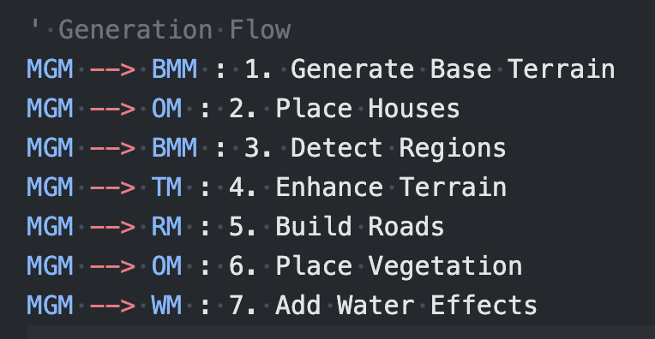
Dynamic Map-Generation
Quellen:

Slide 12
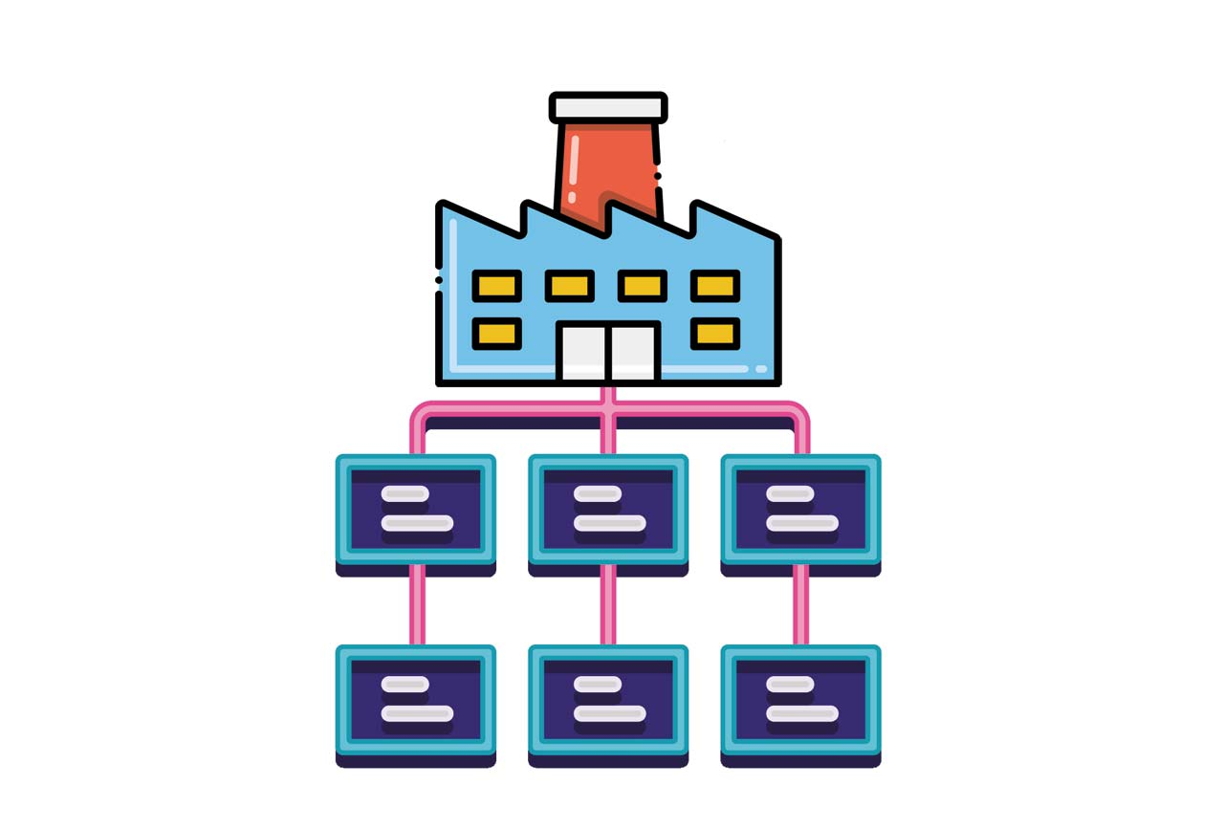
Dynamic Map-Generation
Factory/Builder Pattern with ScriptableObjects
Scripts involved:
MapGenerationManager.cs
BaseMapManager.cs
MapBiomeConfig (ScriptableObject)
BaseRegion.cs and its derivatives
The map generation system uses a sophisticated Factory/Builder pattern combined with ScriptableObjects for configuration.
Each region type (BaseRegion and its subclasses) is created through a builder-like process.
Quellen:

Slide 13
Dynamic Map-Generation
Composite Pattern in the Region Structure
Scripts involved:
BaseRegion.cs
EarthRegion.cs
GrassRegion.cs
LakeRegion.cs
HouseRegion.cs
The region hierarchy utilizes the Composite Pattern, where BaseRegion defines the common interface and various region types implement it. Each region can consist of multiple tiles that are treated as a unified object.

Slide 14
Setup in 3D

Slide 15
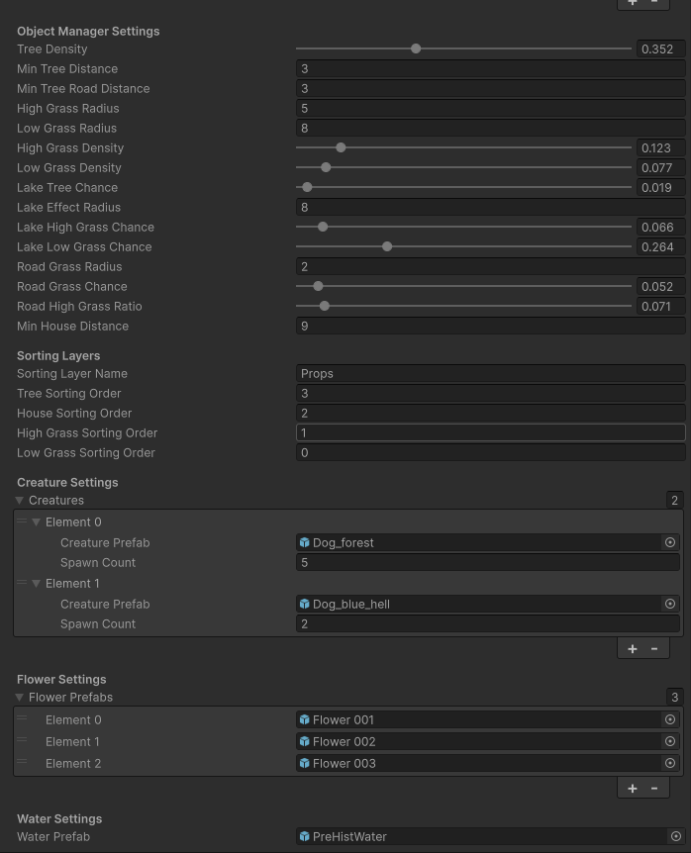
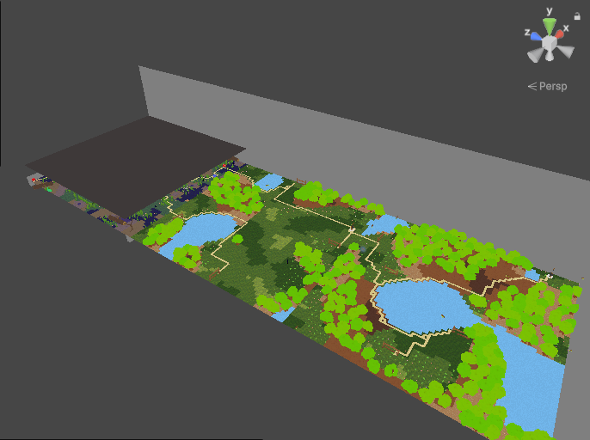


Setup in 3D
BiomeConfig as ScriptableObject, with lots of parameters to customize the look of each biome

Slide 16
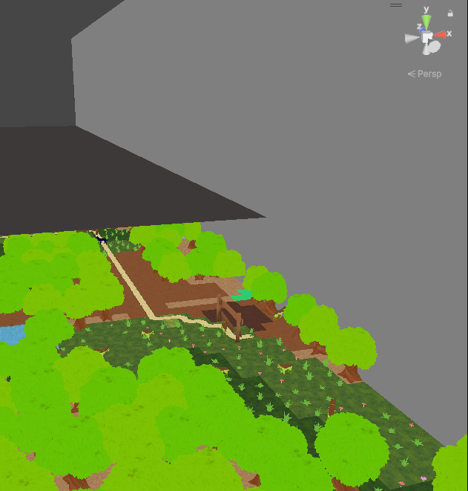
Setup in 3D
// Use of 3d Planes to limit the Space towards the sides and bottom
3x Biomes (levels)

Slide 17
Setup in 3D
// Use of 3d Planes to limit the Space towards the sides and bottom
Gravity: y = -9.81
3D Ground panel, because grid did not work as a solid ground for creatures
The Grid containing all the Layers is rotated 90 degrees in positive x direction, what is weird since the 3d ground-panel is not rotated in any direction

Slide 18
Creatures | Objects | Prefabs | Assets

Slide 19
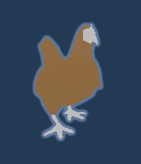
Creatures | Objects | Prefabs | Assets
// Use of 3d Planes to limit the Space towards the sides and bottom
I have been searching the web for applicable 3rd party assets to use in my project
I have tried several AssetPacks containing (mostly 3d): houses, vegetation (grasses, trees), other objects (fences, fires)
Most Importantly I discovered a pack (‘Animals’) which contains animated creatures their 3d models and everything one needs to integrate into a project
Here I decided I want to go for a third person PlayerCreature: TheChicken
The AssetPack came with a script for controlling the creature which was very helpful (I adapted it for my own use)
The AssetPack came with multiple Prefabs, which I uitilized as enemies

Slide 20
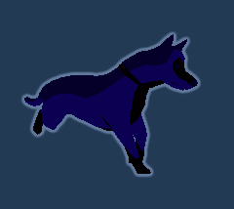
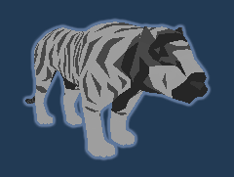
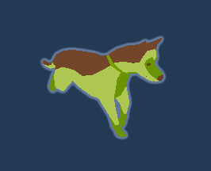
Creatures | Objects | Prefabs | Assets
// Use of 3d Planes to limit the Space towards the sides and bottom
PlayerCreature:
Has tag ‘Dice’ in Code, since before the chicken I had a dice as PlayerFigure
Can Move (wasd)| Sprint (shift) | attack (J)
Dogs:
I‘m most proud of the customized dogs
Utilized materials from other asset packs to differentiate
Tiger:
Spawns in the last Biome
Has most powerful stats
3x Enemies

Slide 21
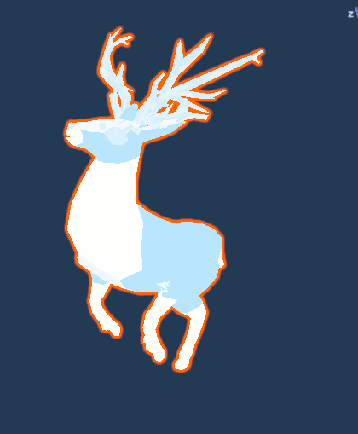
More Creatures? No Problem!
Just an idea:
Befriendable Behavior
Tame by channeling an ’attack’
Large mana cost
Collects flowers and by that provides useful +stats for the playerCreature

Slide 22
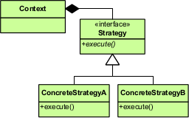
Creatures | Objects | Prefabs | Assets
Strategy Pattern
Strategy Pattern in Creature Behaviors
Scripts involved:
CreatureBehavior.cs (abstract base)
AggressiveCreatureBehavior.cs
BasicCreatureBehavior.cs
BehaviorController.cs
different creature behaviors are encapsulated in separate classes. The abstract CreatureBehavior defines the interface!
AggressiveCreatureBehavior and BasicCreatureBehavior provide movement strategies. The BehaviorController can dynamically switch between behaviors based on context

Slide 23
UI

Slide 24
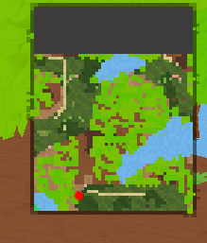
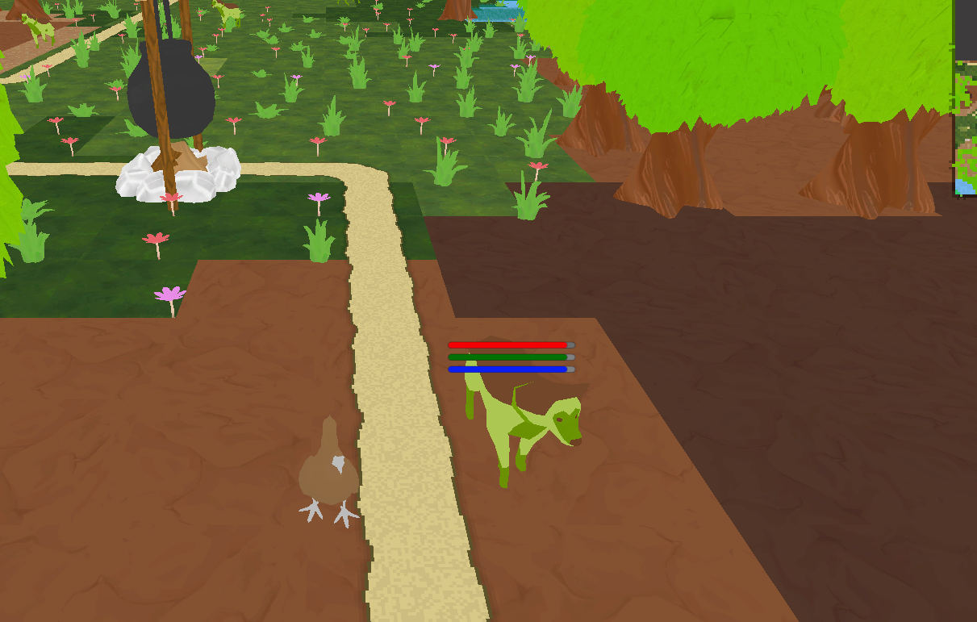
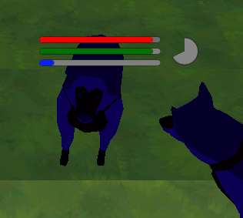

UI: Minimap, CreatureStats, ItemInteraction-floatable
Minimap with RedMarker:
Conveys an overview of the terrain
CreatureStatsUI for NPC-Creatures:
Updated Creature stats in RealTime
CoolDown Indicator
PlayerStatsUI: fixated at bottom of the screen

Slide 25
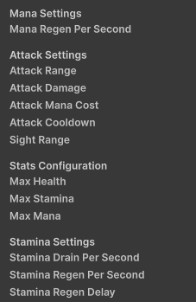
CreatureStats & Interaction‘s
Each Creature Prefab has a Component: CreatureStats
This Component is an interface that modifies the stats of creatures
It is used by external sources like the Item-Interaction’s
This is not as sorted as it could be…
This could me more comprehensive (as you see there is still no HealthRegen)
There is always more toDo
It is very versatile and easily adapted

Slide 26
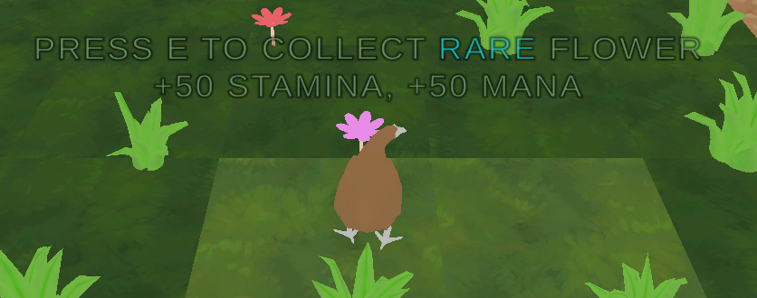


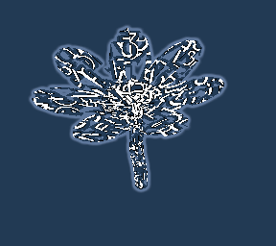
CreatureStats & Interaction
3 flowers with 3 different rarity-levels
Each modifying different stats
Each with different unity materials
Interacts with CreatureStats component
3x Interactables

Slide 27
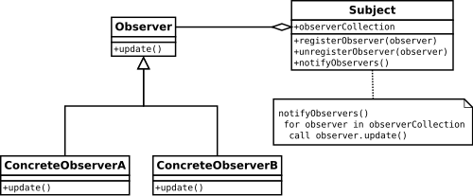
Creatures | Objects | Prefabs | Assets
Observer Pattern
Scripts involved:
CreatureStats.cs (subject)
PlayerCreatureStatusUI.cs (observer)
PlayerRemover.cs (observer)
BiomeAccessController.cs (observer)
The creature stats system uses the Observer pattern where CreatureStats acts as the subject, notifying various observers about health/status changes. Observers like the UI, death handler, and biome controller respond to these changes independently.

Slide 28
THX <3
Ostbayerische Technische Hochschule (OTH) Amberg-Weiden Kaiser-Wilhelm-Ring 23 | 92224 Amberg
Tel.: +49 (9621) 482-0 Fax: +49 (9621) 482-4991 amberg@oth-aw.de

Slide 29
Technical Information
The up2date scene that should be working for everyone is called „PMOV“
Switch to this scene and press play button
It should take a while to load and generate everything
Once the Chicken has dropped to the floor you can start exploring
I am on Apple Silicon
What else do you need to be able to easily run my game?
Feel free to write an e-mail or contact me elsewhere:
E-mail: n.baierl1@oth-aw.de
Mobile: +49 1512 8958396

Slide 30
Personal Notes
There is always more to do (LevelSystem, better WaterLogic…)
This is not really a finished game, but I believe it is a solid foundation for further development
The water in the game has not really any effect on gameplay yet -> my idea is that in the future creatures will avoid it more strictly through their behavior
The code could be structured better: I have only taken the time to sort everything once (Midterm), and by the time I write this comment i do not want to make big refactorings (10.07.25, 22:15)
The Code is mostly implemented with and by VSCopilot, however all the creative work and ideas stem from my own personal effort -> this would not have been possible withouth regarding c# beeing a language i have never programmed before and other reasons
The Name of the Game is not PixelPost-> the directory is still misnamed

Slide 31
Farbcode
Und Schriften
Aufrasterung 1
Aufrasterung 2
Aufrasterung 3
238 | 113 | 0
#ee7100
60%
40%
20%
Bitte folgende Fonts nutzen:
Meta OT Bold für Überschriften
Meta OT Regular für Text
Schriftfont steht im Prozessportal zum Download zur Verfügung
Wichtig: Diese Farbwerte gelten nur für die
PowerPoint-Präsentation. Für den Web- und
Druckbereich gelten die Werte im CD-Manual!
83 | 85 | 90
#53555a
60%
40%
20%
31 | 177 | 204
#1fb1cc
60%
40%
20%
108 | 53 | 128
#6C3580
60%
40%
20%
69 | 177 | 121
#45b179
60%
40%
20%
0 | 103 | 159
#00679f
60%
40%
20%

Slide 32
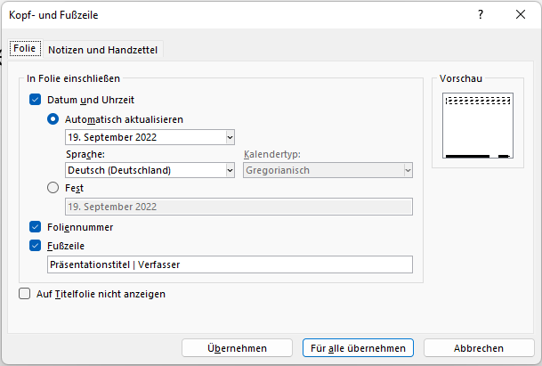
Fußzeile
Wie Sie die Fußzeile anpassen
1
1
Öffnen Sie das Fenster Kopf und Fußzeile. Einfügen > Kopf und Fußzeile
Geben Sie unter Fußzeile Ihren gewünschten Text ein. Sie können hier auch das Format für das Datum ändern oder dieses komplett entfernen.
Bestätigen Sie Ihre Eingabe über „Für alle übernehmen“, um die Fußzeile in der gesamten Präsentation zu ändern.
2
3

Slide 33
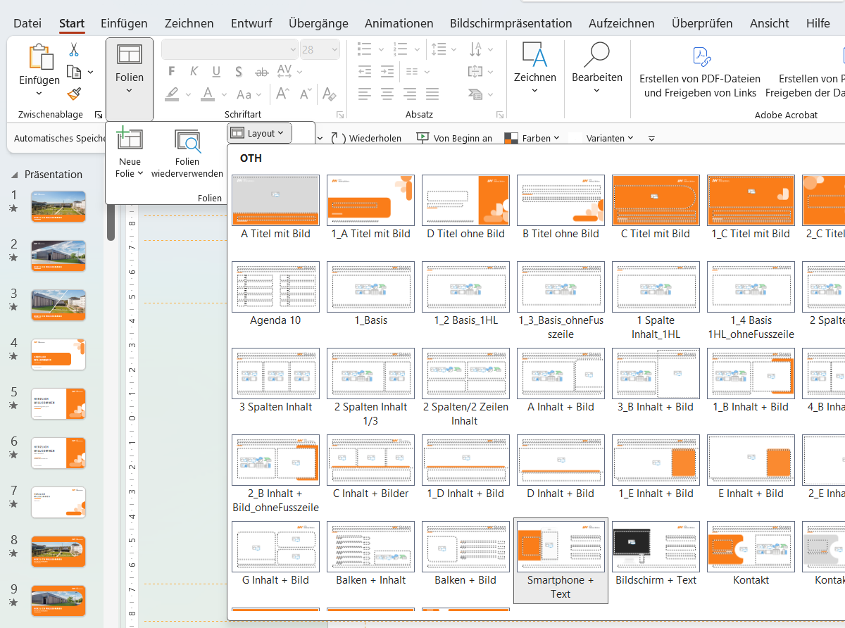
Neue Folie
Wie Sie Folien richtig einfügen
Unter Start finden Sie den Reiter Neue Folie. Klicken Sie auf den daneben stehenden Pfeil. Start > Pfeil neben „Neue Folie“
Wählen Sie das gewünschte Layout aus. Mit einem Klick darauf erscheint die Folie in der Präsentation. Nun können Sie die Folie nach Ihren Vorstellungen anpassen.
Hinweis: Ein Kopieren von Seiten ist nicht empfohlen, da sich die Chance auf eine durchgehende Fehlerquelle erhöht.
1
1
2
2
00

Slide 34
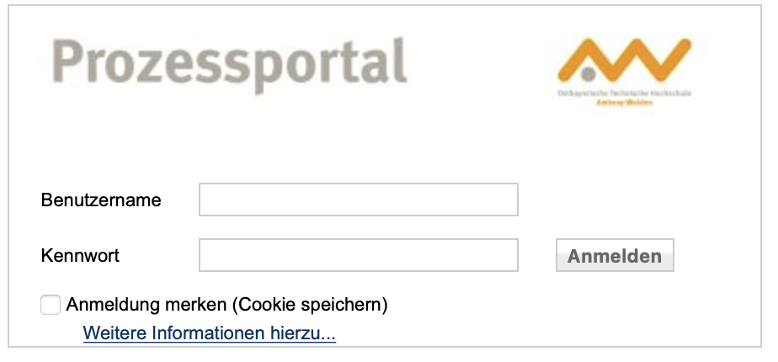
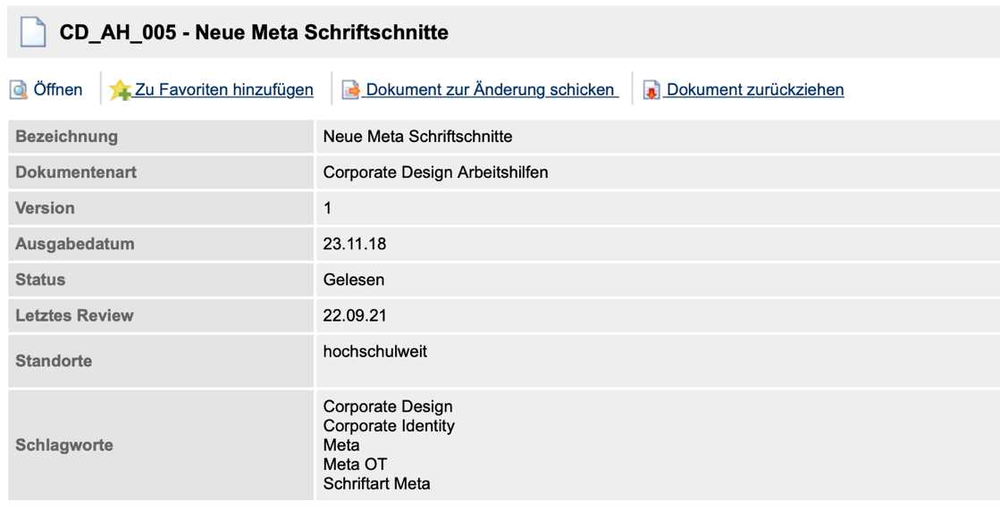
Schriftdateien
Wie Sie Meta OT downloaden
Unter folgendem Link finden Sie Meta OT: https://prozessportal.oth-aw.de/DynDokWeb/document/de-DE/D2243 Um sich in das Prozessportal einzuloggen, müssen mit dem Hochschulnetzwerk verbunden sein (vor Ort oder per VPN).
Downloaden Sie den Ordner Neue Meta Schriftschnitte und installieren Sie den Font auf Ihrem PC.
1
2

Slide 35
Icons
Zur freien Verwendung

Slide 36
Icons
Zur freien Verwendung

Slide 37
Icons
Zur freien Verwendung

Slide 38
Icons
Zur freien Verwendung

